Slide 1
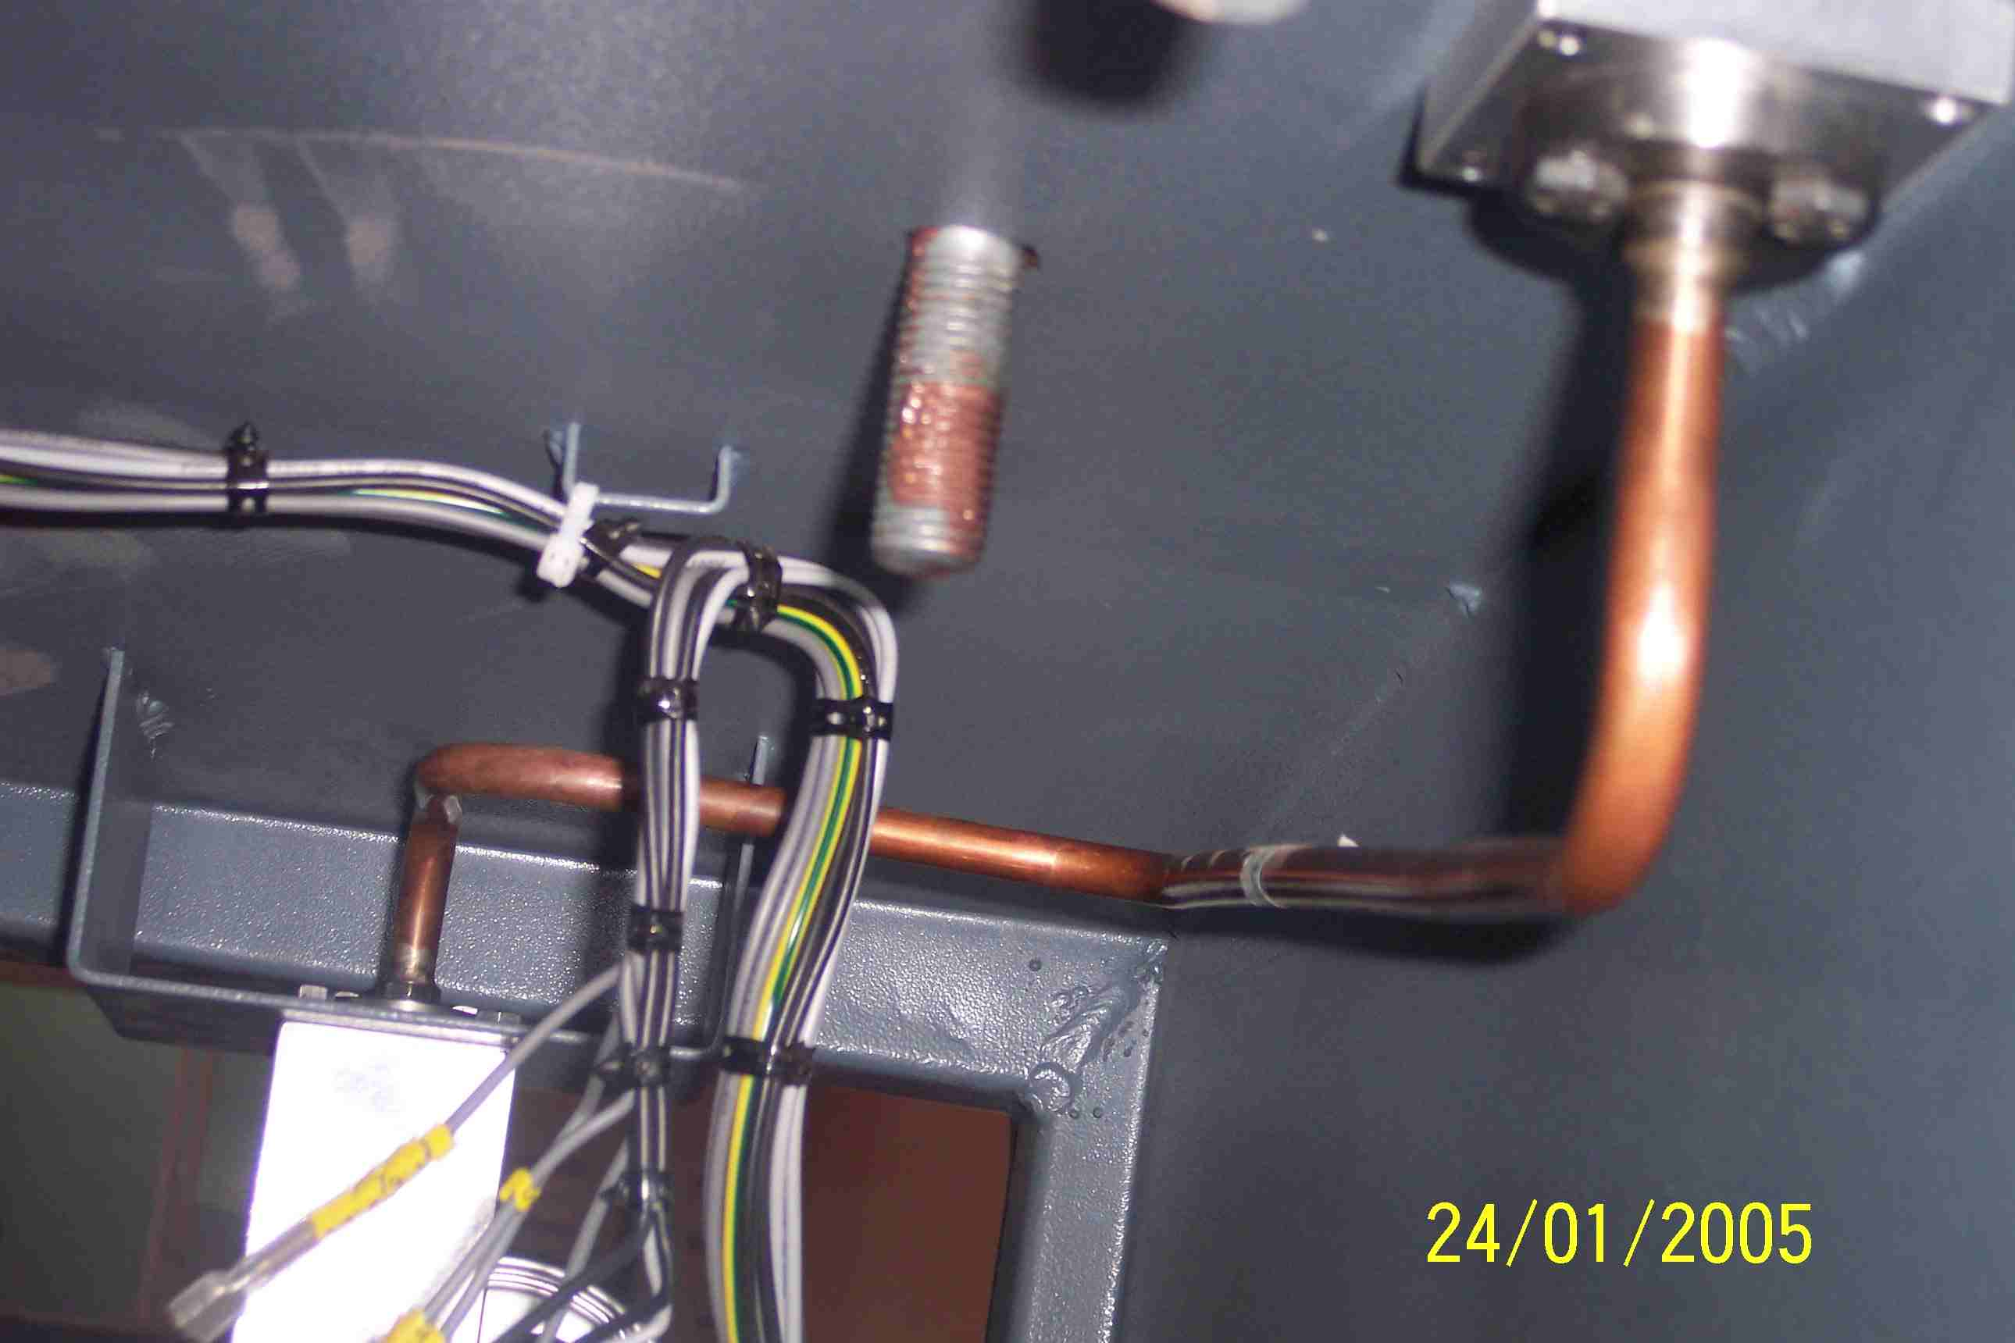
SIEMENS
HVCB SPARES
Small Gas pipe-2, 72.5KV, 31.5KA CB
S4713615701

